Slide 1
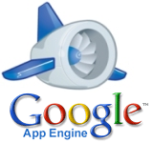
Google App Engine
(a breverly overview)
Denis Ruiz Castellón

Slide 2
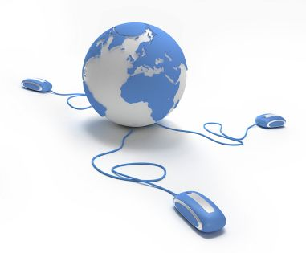
Agenda
Introduction
Demostración
  Instalación de Google App Engine
  Modificando los archivos
  Creando la Aplicación
  “Deploying” la aplicación
Posibles Errores

Slide 3
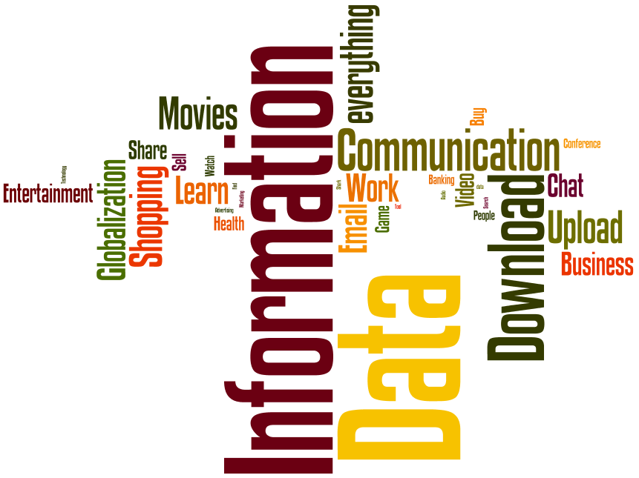
Introduction

Slide 4
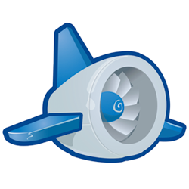
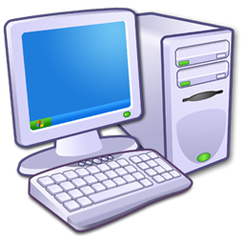
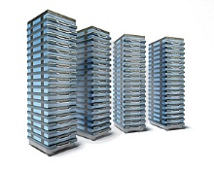
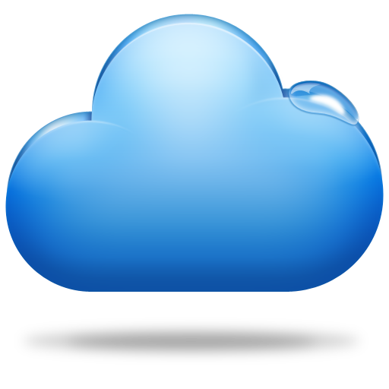
The Request/Response Cicle
HTTP Request
Internet
HTTP Response
To build a web application, you need to have a general understanding of all aspects of the request/response cycle and what is happening at both ends (browser and server) of the request/response cycle.
The cycle involves making a request and getting a response across the Internetby connecting to software and data stored in data centers connected to the Internet
Notes:
The request/response cycle is pretty easy to understand. It starts when the user clicks
on a web page or takes some other action and ends when the new page is displayed to
the user. The cycle involves making a request and getting a response across the Internet
by connecting to software and data stored in data centers connected to the Internet
When your browser makes the connection, requests a document, and sends any input
data that you have typed, it is called an “HTTP request” because your browser is requesting
a new document to display.
When the server receives the request, it looks at
the document that is being requested (/search), which user the request is coming from
(in case you have previously logged in with this browser), and the data from any input fields. The server application then pulls data from a database or other source of data,
produces a new HTML document, and sends that document back to your web browser.
When your web browser receives the new HTML document, it looks at the HTML
markup and CSS (Cascading Style Sheets), formats the new page, and shows it to you.

Slide 5
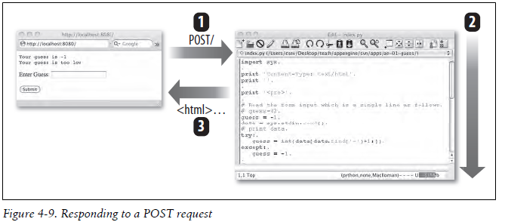
Client/Server Model

Slide 6
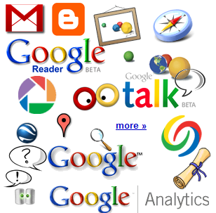
Google’s Products

Slide 7
Google App Engine
“Google’s App Engine opens Google’s production infrastructure to any person in the world at no charge”
Falta la referencia acá del libro

Slide 8
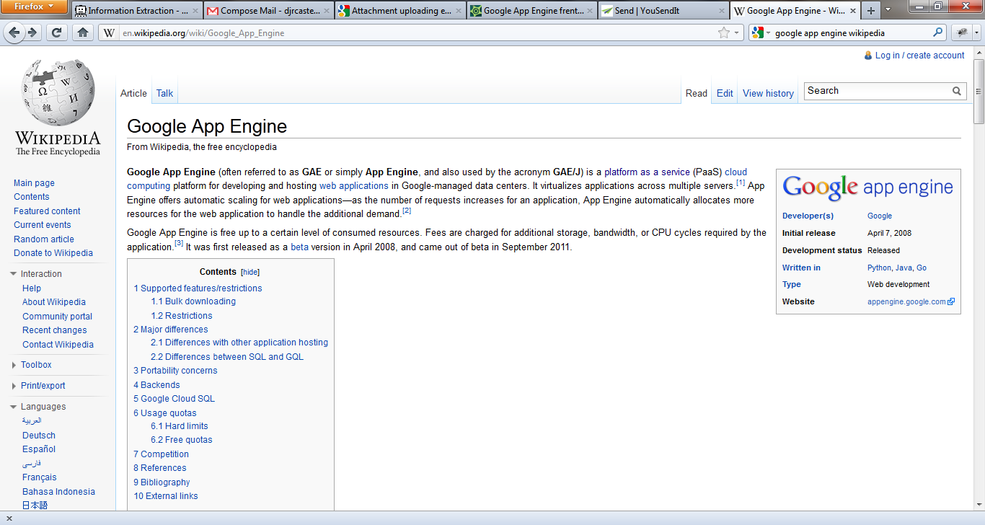
Google App Engine (GAE)
GAE is a platform as a service (PaaS) cloud computing platform for developing and hosting web applications in Google-managed data centers.
Falta la referencia acá del libro
Why is it free?
Google App Engine is to make the Web better
Notes:
By opening App
Engine up to the public, thousands of new bright developers are poring over every
aspect of Google App Engine, testing, checking, poking, prodding, finding problems,
and suggesting fixes and improvements. This process greatly builds the community of
knowledge around the Google software environment, while keeping Google’s costs
low.

Slide 9
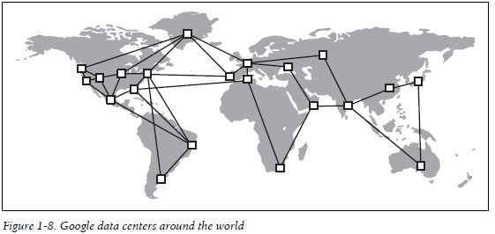
How the Cloud Runs Your Application
The Google cloud is more like a cellular network.
Programs and data “roam around” the world and the web requests (like cellular calls)
Notes:
The Google cloud is more like a cellular network. Programs and data “roam around”
the world and the web requests (like cellular calls) somehow find their way to your
software, regardless of where in the world your software happens to be running. If you
have an App Engine application running at a domain name of cloudcollab.appspot.
com, Google can give this domain name a different IP address depending on what
region of the world you are coming from. In the eastern United States, you might get
one numeric IP address, and in South Africa, you might get another numeric IP address.
Once Google gets your request into the Google network, it figures out which data
center(s) can run your application or perhaps which data centers are already running
your application. It probably picks a data center that is some combination of reasonably
close and not currently overloaded or perhaps the data center where the data for your
application is stored. If all of a sudden your application experiences a spike of traffic
in the United Kingdom, Google will likely copy your program and some of your data
to one of its data centers there and start your application in that data center and pass
the incoming requests from the United Kingdom to your program running in the United
Kingdom.
If your application is very popular, it might be running in a number of different data
centers at the same time. Or if your application gets 10 requests per hour, it probably
is not running anywhere most of the time. When Google sees a request for your application,
it starts up a single copy somewhere and gives the request to your application.
Once your application finishes the request, it is shut back down to conserve resources.
The most important point of this is that your application has absolutely no idea if or
when it is running, where geographically it is running, and how many copies of it are
running around the world. Google takes care of all those details for you completely and
(thankfully) hides them from you. Somehow the requests from your users make it to
your application and back to the end user—Google takes all the responsibility for
making this happen quickly and efficiently.

Slide 10


Why You Really Want to Run in the Cloud
What operating system should I run?
What version of theoperating system is the most reliable?
When do I apply vendor patches (especially those pesky security patches)?
How do I protect my system from intruders?
Do I need a firewall to protect my servers?
How do I monitor my servers to detect when an intrusionhappens and then how do I get notified? ...(So many thing to do)
What should I program?
OUT THE CLUOUD
IN THE CLOUD
Notes:
These problems do not go away just because you run on the Google
infrastructure. But they are Google’s problems, not your problems.

Slide 11
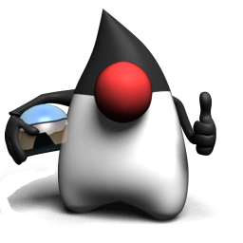
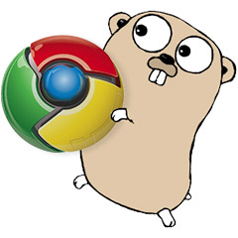
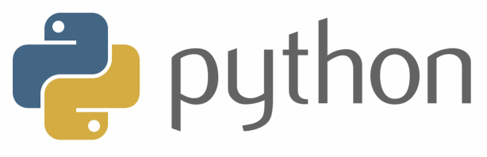
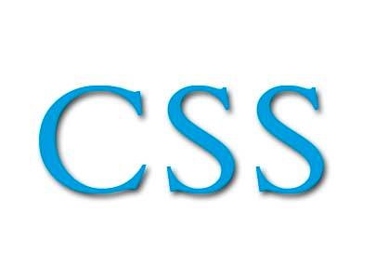
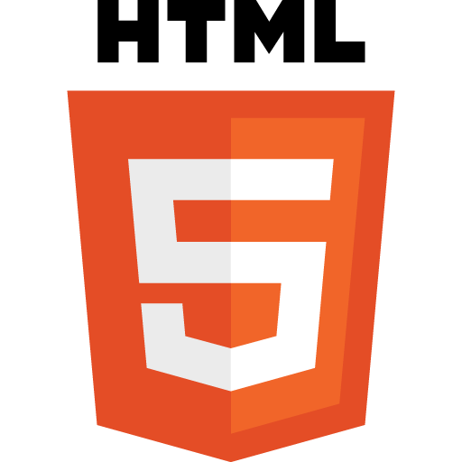
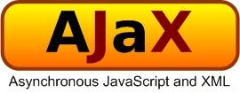


What about programming languages?
Notes:
GO es de código abierto y se basa en la familia de programación de C pero con elementos de Python y la familia de Pascal, Modula y Oberon.

Slide 12
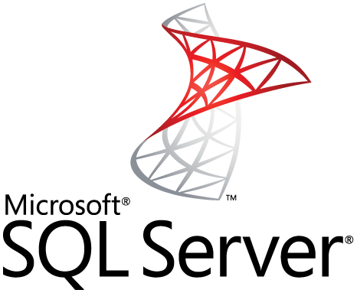

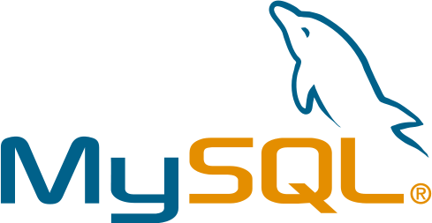
What about Databases?
When using Google App Engine, we do not have access to a traditional relational Database!
Google’s Bigtable technology
Notes:
GO es de código abierto y se basa en la familia de programación de C pero con elementos de Python y la familia de Pascal, Modula y Oberon.
The focus of Bigtable and the Google Datastore is to achieve efficient application scalability
within the Google cloud, given the dynamic and distributed nature of the Google
production infrastructure.
For users who are familiar with relational databases, the Google Datastore will seem
somewhat different. Beginning users may find that the Google Datastore is much simpler
to get started with than a relational database would be. If you learn the App Engine
Datastore first and then switch to relational databases, you might find relational databases
a bit clunky compared to the App Engine Datastore.
The Google App Engine Datastore, much like with templates, uses syntax similar to
the approach that Django uses to describe its Models.
We will explore basic use of the Datastore by modifying our application to allow users
to create real accounts with real passwords and store those user accounts in the
Datastore.

Slide 13
Databases
Accesing to Data
  We do not have access to a traditional relational database such as Oracle, MySQL, or SQLite.
  Hierarchical object-oriented storage approach
  The Google Datastore is based on Google’s Bigtable technology
  More info:
BigTable es un motor de bases de datos creado por Google con las características de ser: distribuido, de alta eficiencia y propietario. Está construído sobre GFS (Google File System), Chubby Lock Service, y algunos otros servicios y programas de Google, y funciona sobre 'commodity hardware' (sencillos y baratos PCs con procesadores Intel).

Slide 14
DataStore
The focus of Bigtable and the Google Datastore is to achieve efficient application scalability within the Google cloud, given the dynamic and distributed nature of the Google production infrastructure
The Google App Engine Datastore, much like with templates, uses syntax similar to
the approach that Django uses to describe its Models.
Notes:
For users who are familiar with relational databases, the Google Datastore will seem
somewhat different. Beginning users may find that the Google Datastore is much simpler
to get started with than a relational database would be. If you learn the App Engine
Datastore first and then switch to relational databases, you might find relational databases
a bit clunky compared to the App Engine Datastore.

Slide 15
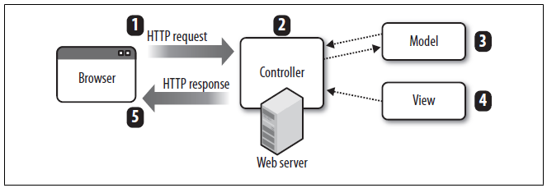
MVC Pattern
The persistent data that we keep in the database
The code that does the sequencing and decision making (i.e., the handlers in index.py)
HTML, CSS and so on that bring about the look and feel of the application
Pág 154
Notes:
The controller orchestrates all of the other activities. The controller receives the incoming
HTTP request, handles the session, makes any Datastore changes, and then
selects the view, renders the view, and sends back the HTTP response.
When the controller is working with the Model, sometime there is some new data from
input that needs to be put into the Model, and sometimes there is some data that needs
to be retrieved, even while processing a single HTTP request

Slide 16


Quotas and Limits
For free
  An application on a free account can use up to 1 GB of storage
  Up to 5 million page views a month.
  You can register up to 10 applications per developer account
<- More Info.

Slide 17

The Rules!
Your Application Must Be a Good Citizen in the Google Cloud
If your application misbehaves, it might be punished.
you cannot write to the disk on the Servers
you just cannot make your own network Connections
Google automatically monitors all the running applications (including yours) to make
Sure that no application uses so many resources that it might have a negative impact on other applications running in the cloud.

Slide 18
Buildding our first App with GAE

Slide 19
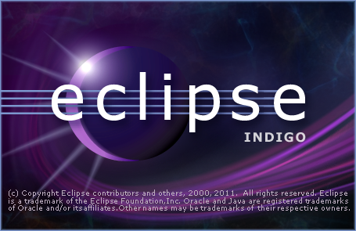
What do we need?

Slide 20
Java tools
The Google Plugin for Eclipse adds features to the Eclipse IDE for App Engine development, testing and deployment, and includes the complete App Engine SDK.
The Eclipse plugin also makes it easy to develop Google Web Toolkit applications and run them on App Engine.

Slide 21
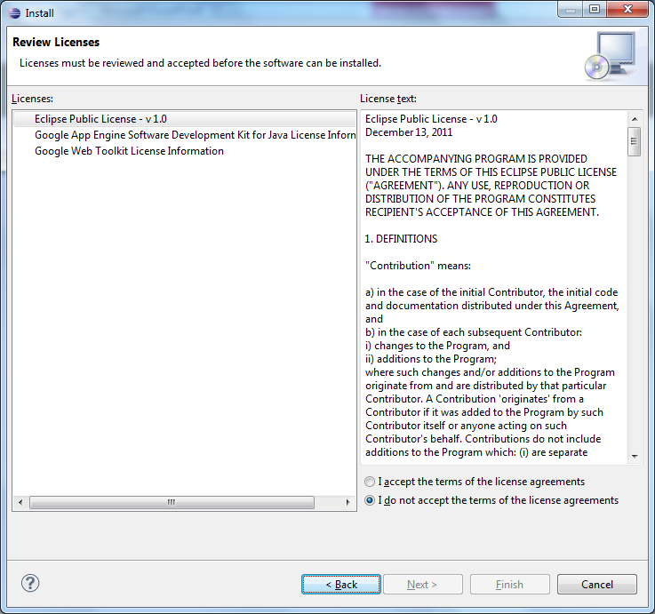
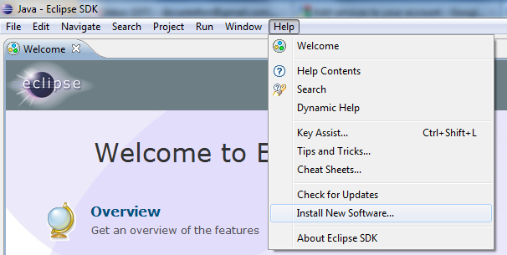
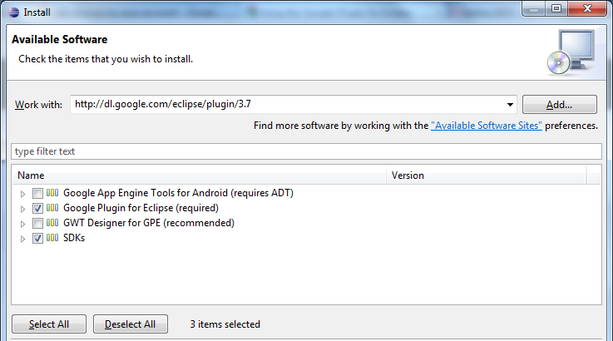
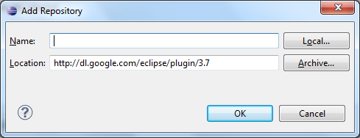
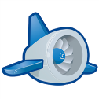
Installing the Google Plugin for Eclipse
Review Licenses
Installing New Software
Working with: http://dl.google.com/eclipse/plugin/3.7
Add Repository
keep the name blank, it will be retrieved from the update site
1
2
3
4

Slide 22
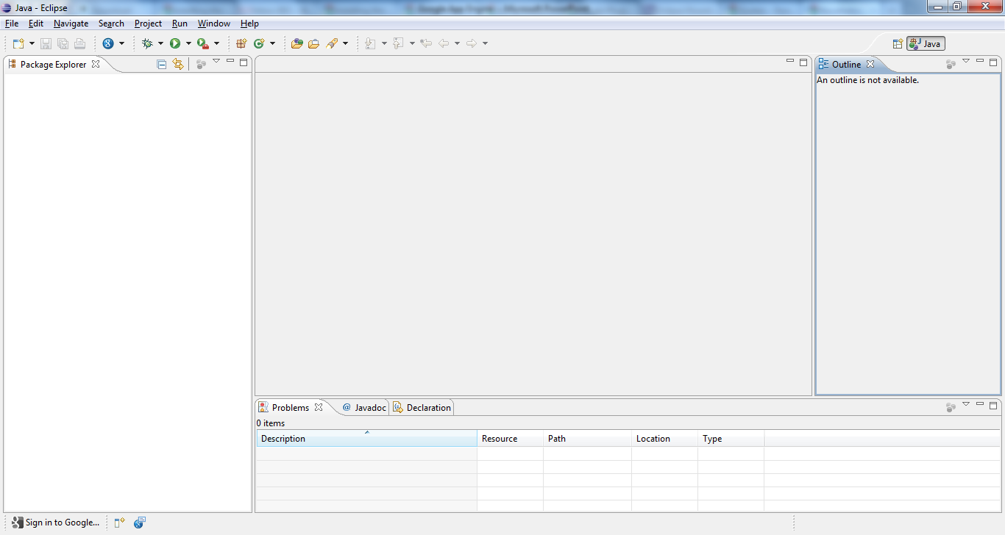


Creating a new project
Turn on your
Development Mode

Slide 23
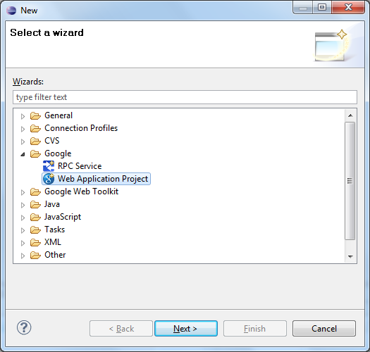
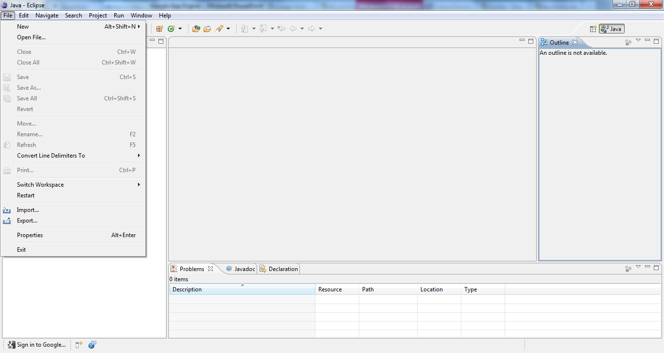
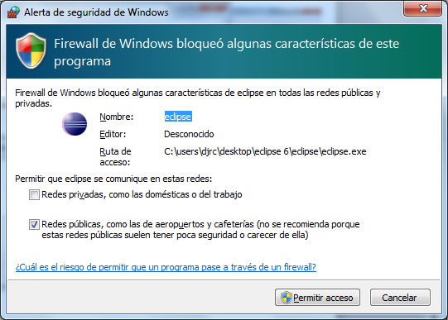
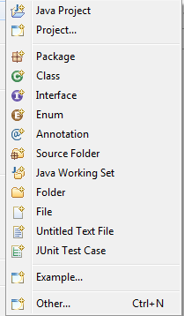
Creating a new project

Slide 24
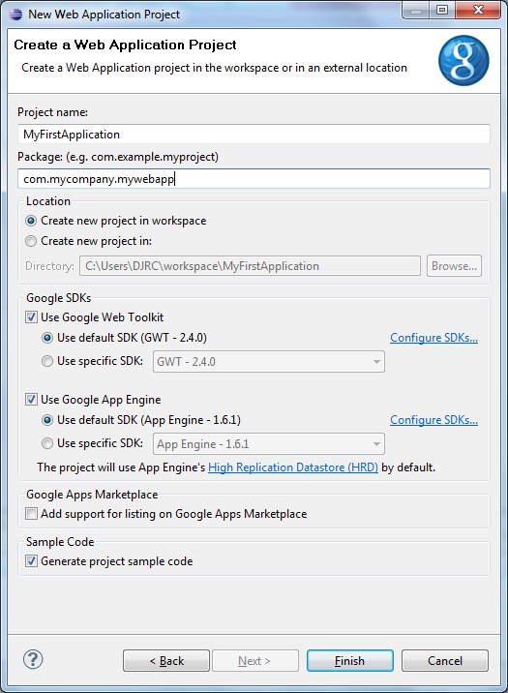
Creating a new project
Enter java package name
e.g. com.mycompany.mywebapp
Enter a name for your project
Congratulations, you now have
a Google Web Toolkit
enabled web application.

Slide 25
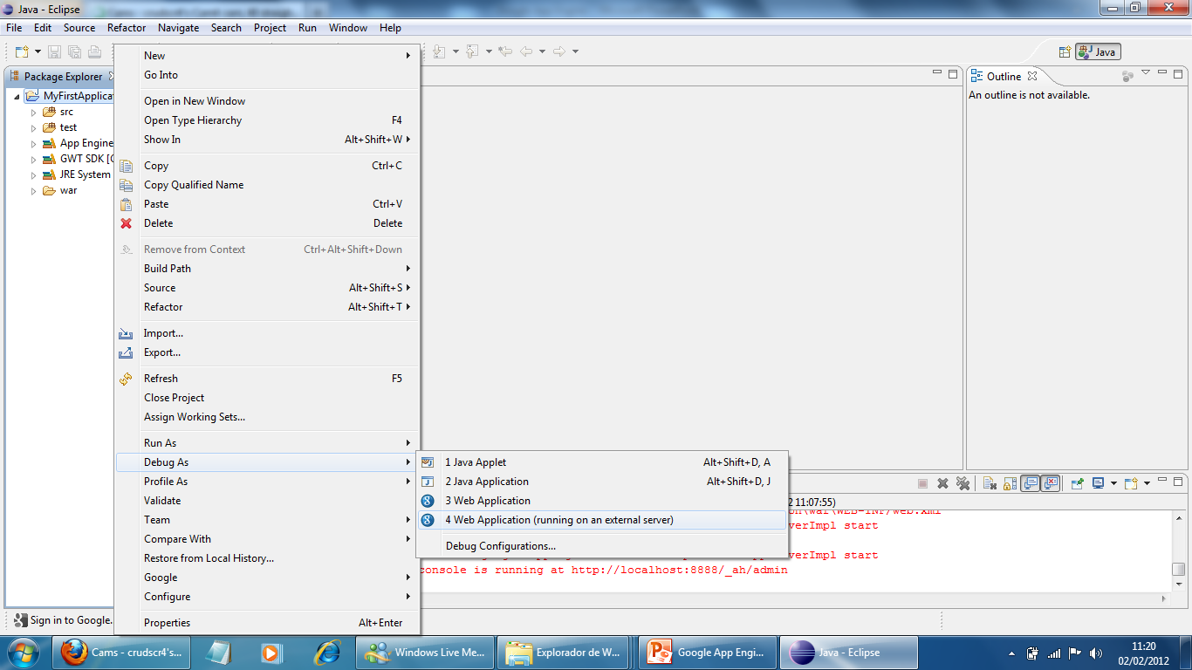
Running your first app

Slide 26
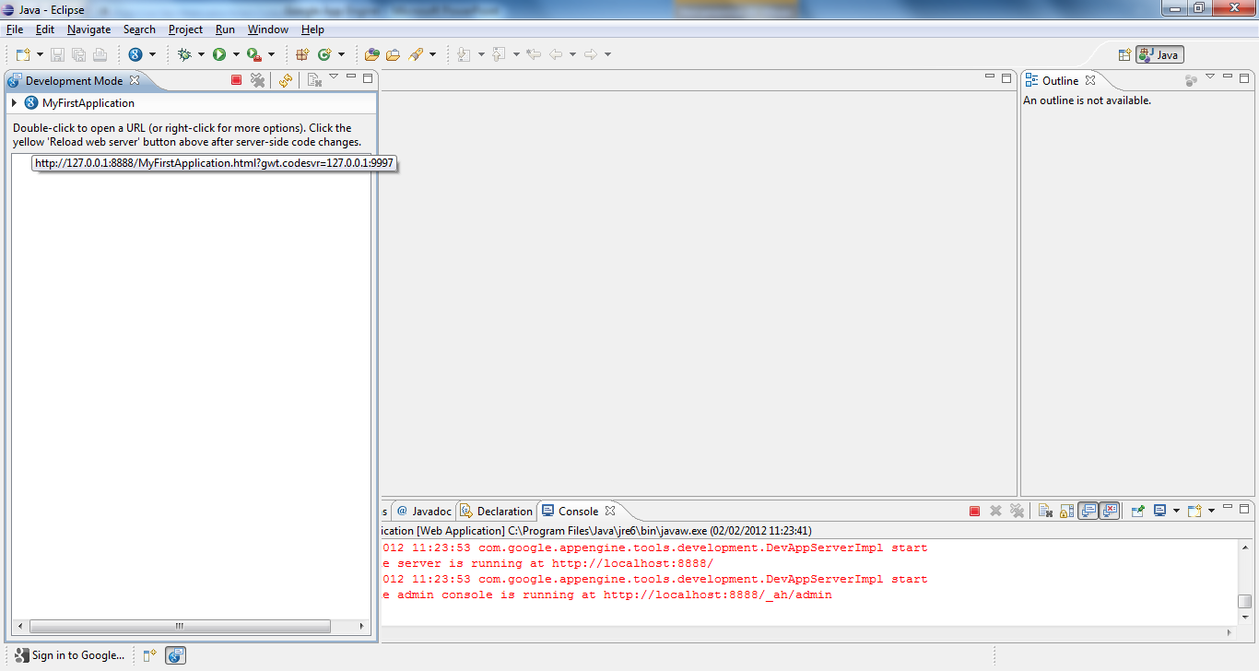
Running your first app

Slide 27
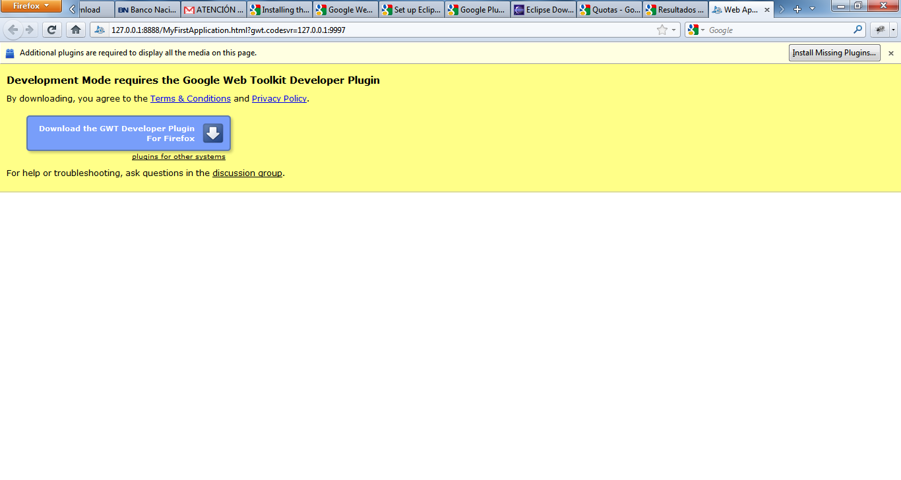
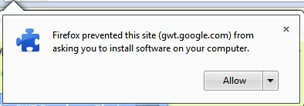
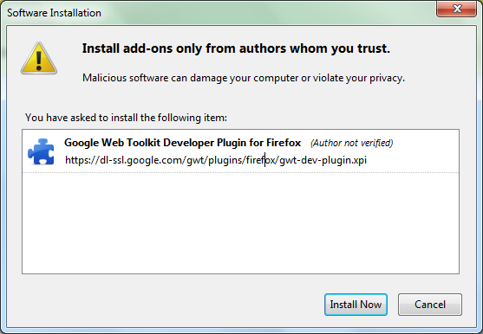
Running your first app

Slide 28
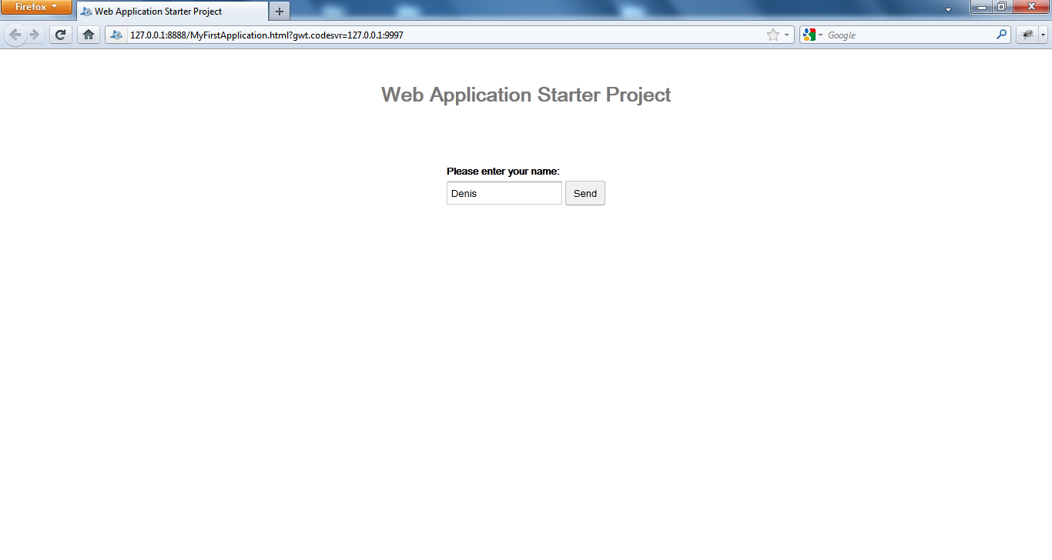
Running your first app

Slide 29
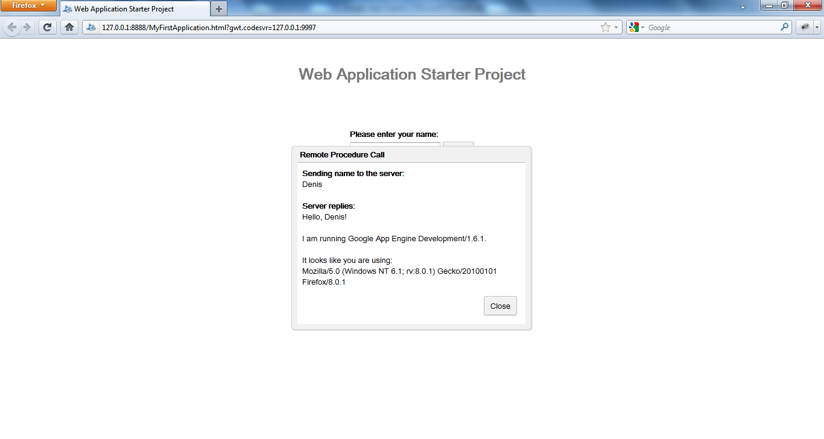
Running your first app

Slide 30
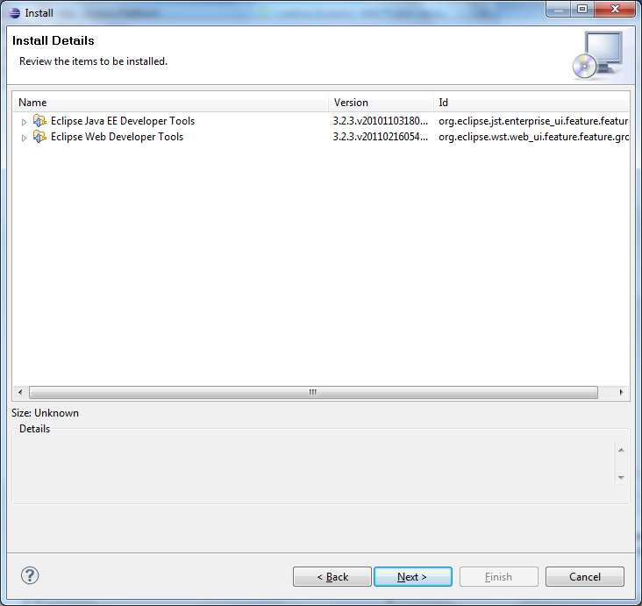

Slide 31
Tools
https://appengine.google.com/
http://dl.google.com/eclipse/plugin/3.7
http://www.wordle.net/

Slide 32
Biography

